Slide 1
A Little Prince
Short school letter to my peers pupils in English , Norwegian , Polish , Hungarian and Turkish school…

Slide 2
Drawings
How pupils by 2nd Primary school of Drapetsona imagine the Little Prince…

Slide 3
A letter from the Little Prince
Dear pupils,
A few months ago I started my journey from my planet ,after I said goodbye to my flowers and my volcano,to meet new people from other planets.
Earth was one of those planets . There I met many beautiful roses , pretty gardens , the desert, a snake and a fox. I became good friends with the fox. She asked me to tame her and she told me a big secret. The real beautiful things are invisible to the eyes, you can only see them with your heart.
I wanted to share this with you, that's why I’m sending you this letter. I will write again
Be well and remember that the beauty is inside us.
With love
The Little Prince

Slide 5
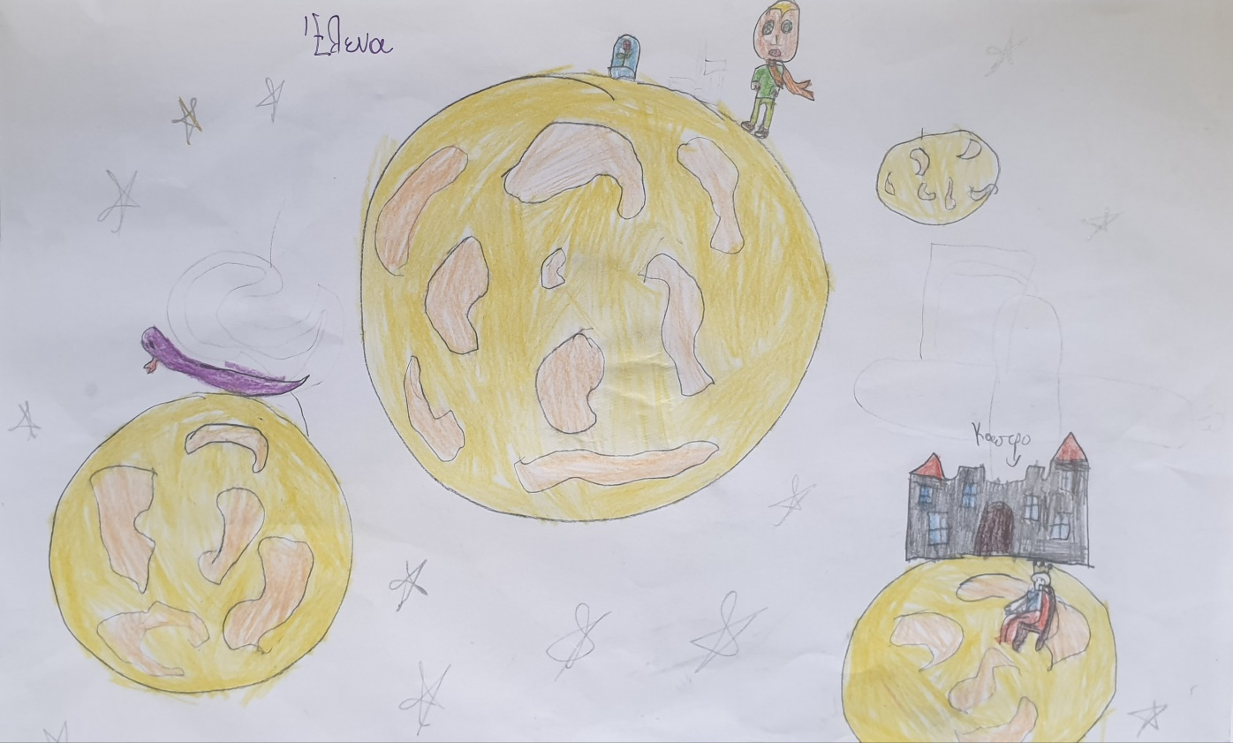

Slide 6
